Slide 1
Module 3 Guidance Notes C++ Basics
COMP2113 Programming Technologies
ENGG1340 Computer Programming II

Slide 2
Before We Start
We will deal with C++ only in this module. and will leave the C counterparts on I/O (i.e., input/output) handling to latter modules.
Important: We will be using the C++ 11 standard, so make sure that your compiler option is set appropriately. We suggest to use the following command to compile your C++ program:
g++ -pedantic-errors -std=c++11 your_program.cpp
The -pedantic-errors flag is to make sure that your code conforms to the ISO C/C++ standard. We will enforce this in your assignment submission too. For more information about C/C++ standards, you may read https://en.wikipedia.org/wiki/ANSI_C and https://isocpp.org/std/the-standard

Slide 3
How to Use this Guidance Notes
This guidance notes aim to lead you through the learning of the C/C++ materials. It also defines the scope of this course, i.e., what we expect that you should know for the purpose of this course. (but should not limit what you should know about C/C++ programming.)
Use “Presentation Mode” in PowerPoint to go through the slides since animations are incorporated which may enhance the flow of reading
Pages marked with “Reference Only” means that they are not in the scope of assessment for this course.

Slide 4
How to Use this Guidance Notes
The corresponding book chapters that we expect you to read will also be given. The reference book may contain more details and information than we have here in this notes, and these extra textbook materials are considered references only.
We suggest you to copy every code segment in this notes to the coding environment and try run the program yourself.
Also, try make change to the code, then observe the output and deduce the behavior of the code. This way of playing around with the code can help give you a better understanding of the programming language.

Slide 5
What are we going to learn?
Part I: Basic Operations
Variables & Constants
Operators
Expressions
Data types & type conversions
Basic input/output
Part II: Flow of Control
Branching
Looping

Slide 6
Reading Materials
A Transition Guide: Python to C++ (pdf available on Moodle)
You are required to read Sections 1 to 3 of this guide for this module
Suggested reading sequence:
Read Section 1 “High Level Programming Languages” of the transition guide. This section discusses the differences in terms of nature and design of the two programming languages which is important if you want to master the languages well.
Follow through Part I “Basic Operations” & Part II “Flow of Control” of this guidance notes
Read Sections 2 & 3 of the transition guide

Slide 7
References
You may check out the followings from C++ tutorials if you need some supplementary readings after finishing this guidance notes:
Structure of a program
Variables and types
Constants
Operators
Basic Input/Output
Control Structures

Slide 8
Basic OPERATIONS
Part I

Slide 9
The First C++ Program
As usual, we will start with the Hello World program.
Now, copy the code and save it in a file named hello.cpp in your home directory.
// this is my first C++ hello world program
#include <iostream>
using namespace std;
int main() {
cout << “Hello World!” << endl;
return 0;
}

Slide 10
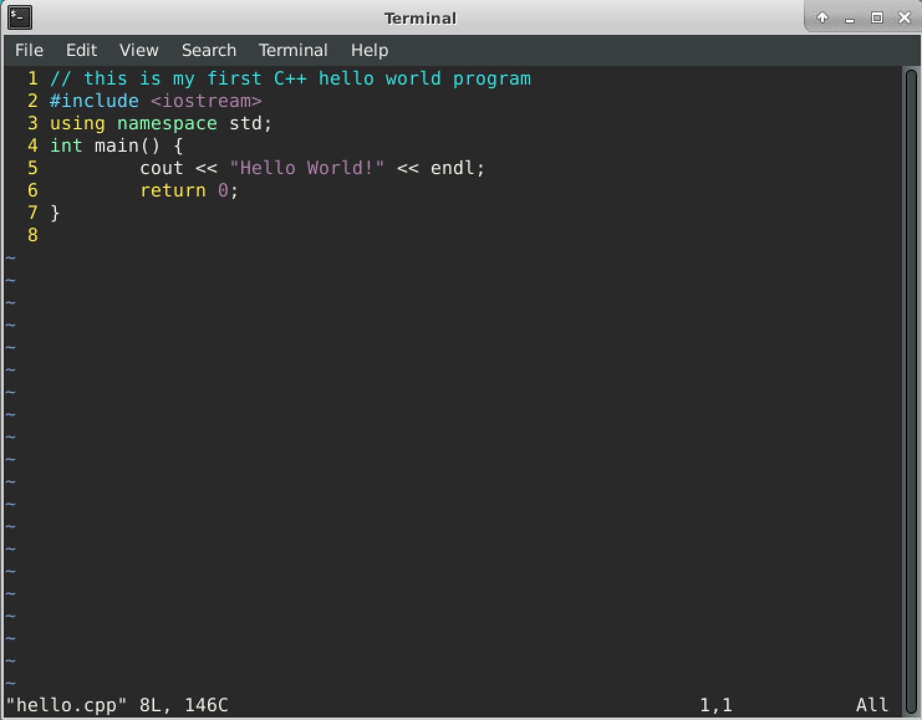
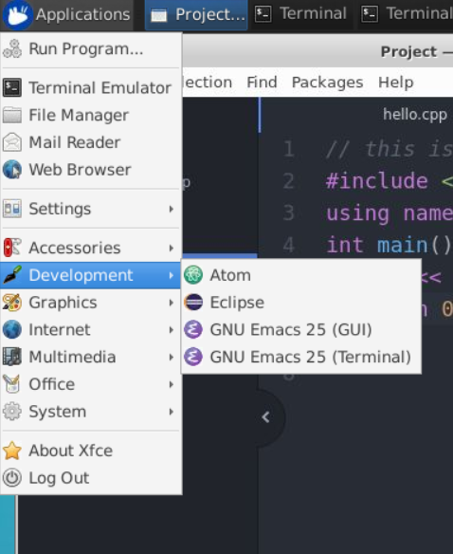
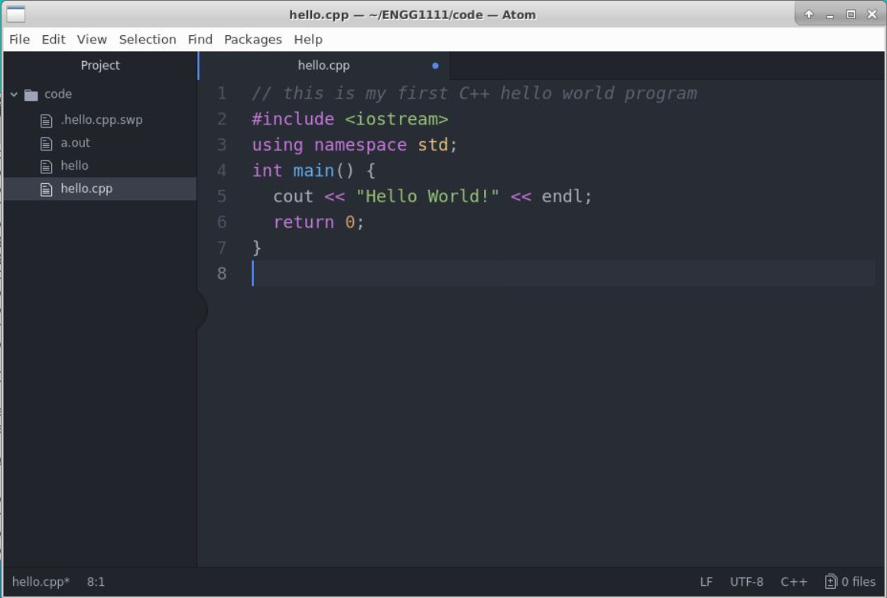
Program Editing
In the Ubuntu (Linux) environment that you have been working on for the previous modules, you may use the vi editor or the Atom editor (https://atom.io/) to edit your program. The Atom editor has a nice graphical user interface (GUI) and can be linked with the gcc compiler to facilitate coding.
hello.cpp in the Atom editor
hello.cpp in the vi editor
Atom is installed in CS server Ubuntu environment

Slide 11
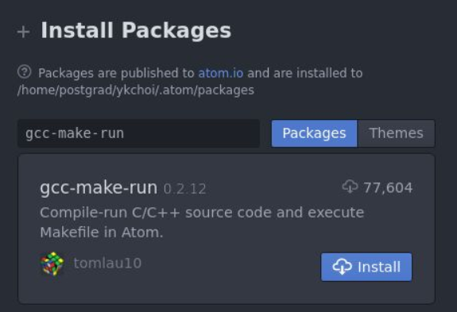
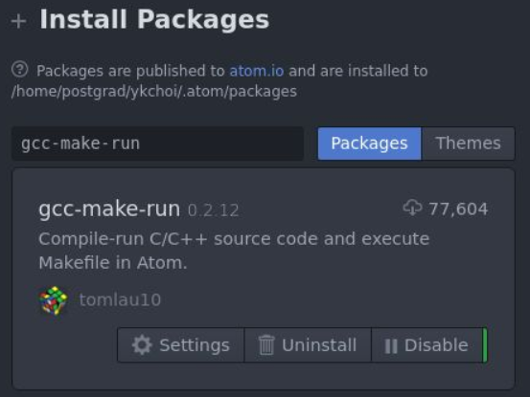
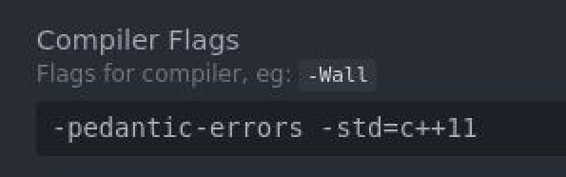
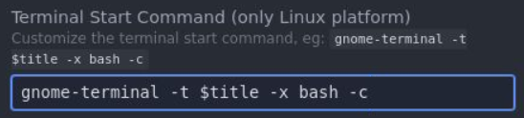
Compiling and Execution
With the Atom editor (in X2Go)
We need to install the gcc-make-run package so we can compile and execute a C/C++ program from within Atom
To do so, in the Atom editor, choose “Packages” -> “Settings View” -> “Install Packages/Themes” from the menu, and search for the “gcc-make-run” package.
Click “Install” and after installation is done, click on “Settings”
Under Compiler Flags, put down “-pedantic-errors -std=c++11”. This is the compiler options that we would use.
Under Terminal Start Command, put down “gnome-terminal -t $title -x bash -c” so that the terminal will fire up while executing your program for standard I/O.

Slide 12
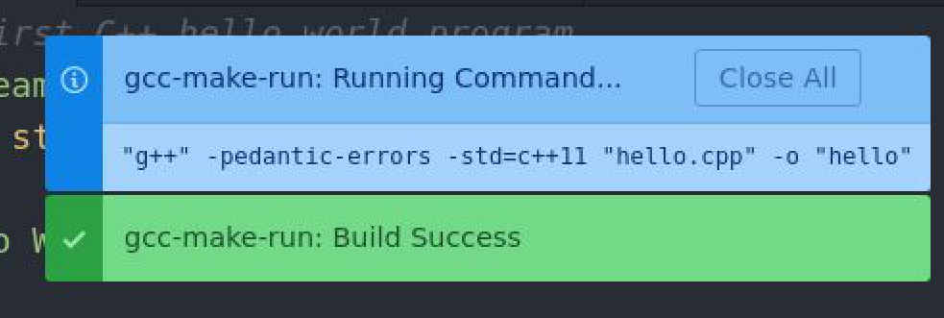
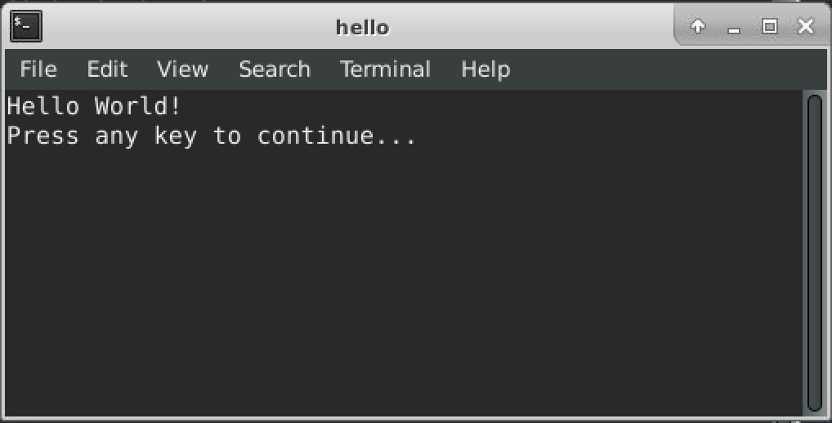
Compiling and Execution
With the Atom editor (in X2Go)
Open hello.cpp.
Press F6 to compile and run the program.
Note that the g++ command line with the flags will be displayed.
A terminal with the program output will be popped up if the compilation is successful.
Now try to remove “;” after “endl” in line 5. Compile and run the program again. What will happen?

Slide 13
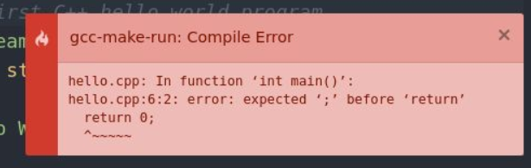
Compiling and Execution
You should get a compilation error.
Take a look at the error message.
It says “hello.cpp:6:2:”, so the error is around line 6.
Read further and it says “expected ‘;’”, so you probably know that is about a missing ‘;’
Now fix the error in the program and compile & run again.
Note: Sometimes the error message is not as “understandable” and “helpful” as this one. We’ll have some hints for you about debugging a C/C++ program.

Slide 14
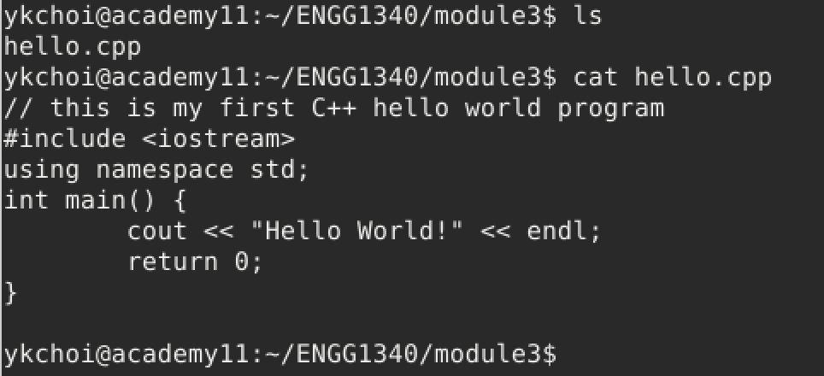
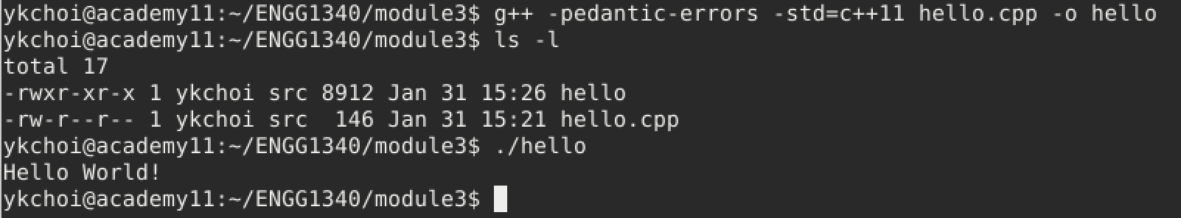
Compiling and Execution
With command line:
Sometimes you don’t have a nice GUI environment to work with, and you will have to rely on command line (via the terminal) for compiling and executing your program.
Now, suppose you already have hello.cpp in your current working directory.
Use this command line to compile hello.cpp: g++ -pedantic-errors -std=c++11 hello.cpp -o hello
If the compilation is successful, you should find another file “hello” in the working directory.
Run the executable “hello” by typing “./hello” at the prompt

Slide 15
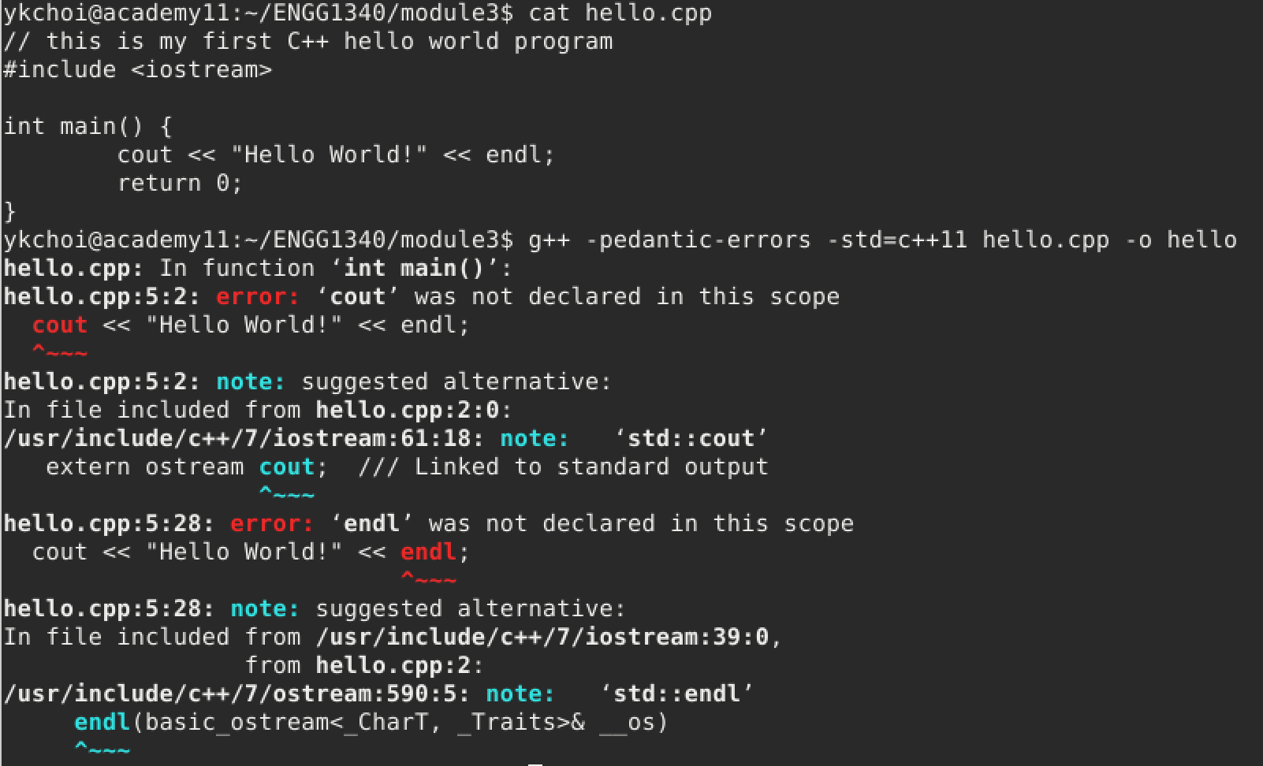
Compiling and Execution
With command line:
Now try again to mess up with your code.
Delete line 3 “using namespace std;”
Compile and run the executable, and note what the error message is.

Slide 16
Hints on Debugging
Hint 1: The line number of an error reported by the compiler may be incorrect. It is possible that the error is located before the reported line. After all, the compiler can only try its best to guess what you meant to write down
Hint 2: For the same above reason, the nature of an error reported by the compiler may be incorrect
Hint 3: If your source code has multiple errors, always fix the first error and recompile, and repeat the process until the compilation is successful. This is because error messages subsequent to the first one have a higher likelihood of being incorrect

Slide 17
The First C++ Program
The Hello World program gives the basic structure of a C++ program.
// this is my first C++ hello world program
#include <iostream>
using namespace std;
int main() {
cout << “Hello World!” << endl;
return 0;
}
A line starting with // is called a comment line, any text after // till the end of line is ignored by the compiler
This is the include directive which tells the compiler where to find information about certain routines used by the program;
iostream is the name of a library that contains the declarations of the routines (cout/endl) that handle input from the keyboard and output to the screen;
Later, you may also use other libraries (e.g., the math library by #include <math>
The iostream object/operation cout and endl are under the namespace std. If this line is removed, then you will need to write std::cout and std::endl without raising a compilation error.
(You can try and look for the error yourselves.)
This is the main function which contains the main body of the C++ program. In this case, we have two statements “cout…” and “return ..” in the main body. The main function is also the starting point of the program execution of all C++ program: the program is executed statement by statement starting from the first statement in this main function

Slide 18
The First C++ Program
// this is my first C++ hello world program
#include <iostream>
using namespace std;
int main() {
cout << “Hello World!” << endl;
return 0;
}
By looking at the output of this program, you probably can guess what this program does. How would you change the program so that it can output Hello ENGG1340! on the screen?
The last statement return 0; in the main function indicates (to the operating system) that the program ended successfully. Note that on C++ compilers and more recent C compilers (C99 onwards), the compiler will add this statement for you if you omit it.

Slide 19
The First C++ Program
// this is my first C++ hello world program
#include <iostream>
using namespace std;
int main() {
cout << “Hello World!” << endl;
return 0;
}
cout is the standard output stream object defined in the iostream library. The standard output is the screen by default.
We will come back to the basic I/O afterwards.
www.cplusplus.com is a good place to look for the definition and usage of the C++ constructs and functions.
You are highly recommended to go through the related topics in their tutorial as well: http://www.cplusplus.com/doc/tutorial/

Slide 20
Variables
Let’s start with how a variable can be defined in C/C++.
Suppose we need a variable named “width”
which is to store an integer.
This statement is called a declaration.
int width;
Variable type
Variable name (identifier)
Used to store data.
Data stored in a variable may change over time.
When we declare a variable, the computer will assign an appropriate number of memory cells in the main memory to each variable according to the type of data to be stored

Slide 21
Variables
What happens in the computer?
1
int main ( ) {
int width;
int height;
…
return 0;
}
Main Memory
width
A memory chunk for storing an integer will be created in the main memory and associated with the name “width”
2
int main ( ) {
int width;
int height;
…
return 0;
}
Main Memory
width
height
Recall that the execution starts from the main() function

Slide 22
Identifiers (Variable names)
An identifier must start with either
a letter (i.e., A to Z, and a to z), or
the underscore symbol (i.e., _)
The rest of the characters may be
letters (i.e., A to Z, and a to z),
digits (i.e., 0 to 9), or
the underscore symbol (i.e., _)
Meaningful identifiers make a program more readable
C++ is case-sensitive
e.g., radius, RADIUS, Radius, etc., are different
Cannot be a keyword in C++
int area;
int length;
int area = length*length;
vs.
int a;
int b;
int b= a*a;

Slide 23
C++ Keywords
Reserved words in C++ with predefined meanings.
CANNOT be used as names for variables or anything else.
asm | do | inline | return | typedef
auto | double | int | short | typeid
bool | dynamic_cast | log | signed | typename
break | else | long | sizeof | union
case | enum | mutable | static | unsigned
catch | explicit | namespace | static_cast | using
char | extern | new | struct | virtual
class | false | operator | switch | void
const | float | private | template | volatile
const_cast | for | protected | this | wchar_t
continue | friend | public | throw | while
default | goto | register | true
delete | if | reinterpret_cast | try
You are not required to memorize all these names. You will get to recognize most of them later on.

Slide 24


Valid identifiers
Which of the following identifiers are valid in C++?
a_man | 2008 | program.cc
const | year1-student | _oOOo_
an integer | change%2 | ABCx123
string | Days_of_Week | friend
cout | delete | cos
Words like cin, cout, string, and cos are NOT keywords in C++. They are defined in libraries required by the C++ language standard. Redefining these words, though allowed, can be confusing and thus should be avoided.
Notes:
most IDE will highlight the keywords.

Slide 25
Data Type of a Variable
Data type is an important concept when using a variable.
Tells the computer how to interpret the data stored in a variable
Determines the size of storage needed to store the data
Some basic data types in C++:
Name | Description | Size | Range
char | Character or small integer | 1 byte | 0 to 255
bool | Boolean value | 1 byte | True(1) or False(0)
int | Integer | 4 bytes | -2147483648 to 2147483648
double | Double precision floating point number | 8 bytes | 1.7e‐308 to 1.7e+308 (~15 digits) -1.7e‐308 to -1.7e+308 (~15 digits)
** The size and range of a particular data type depend on the system under which a program is compiled. The values shown above are those found on most 32-bit systems

Slide 26
Declarations
All variables must be declared before use
A declaration specifies a type, and contains a list of one or more variables of that type
Examples:
Syntax
type_name variable_name;
type_name variable_name_1, variable_name_2, …;
To declare two integer variables named “age” and “steps”
int age, steps;
char c;
bool win;
double height, width, length;

Slide 27
Assignment Statement
A variable may be initialized or its value can be changed at a later time after its declaration using an assignment statement
An assignment statement consists of a variable on the left-hand side of an equal sign, and a value or an expression on the right-hand side
Syntax
variable_name = expression;
int age;
double heights;
age = 5;
heights = 8 * age + 20.5;
a constant value
Example
an expression

Slide 28
Assigning Values to Variables
1
int main ( ) {
int width, height, area;
width = 5;
height = 4;
area = width * height;
return 0;
}
Main Memory
width
???
5
height
???
4
area
???
The variable height is uninitialized before use and the result is unpredictable.
20
2
Main Memory
int main ( ) {
int width, height, area;
width = 5;
area = width * height;
return 0;
}
???
width
5
height
???
area
???

Slide 29
Initializations
A variable that has not been given a value is said to be uninitialized, and will simply contain some “garbage value”
Using uninitialized variables in computations will give unexpected results, and thus should be avoided
A variable may be initialized in its declaration:
int age = 5, steps = age + 10;
char c = ‘Y’;
bool win = true;
double height = 120.5, length = 1.5e3;
A character constant is written as a character within single quotes.
Scientific notation
(floating point notation)
1.5e3 = 1.5 * 10³ = 1500

Slide 30
Strings – the Very Basics
Very often we need to work on textual information and this can be done in C++ using strings (C has a different handling of strings and we will discuss that later)
A string variable is just a variable containing a sequence of characters
Strings are not the one of the fundamental C++ data types but are so frequently needed that they are defined as a class within the standard library.
Include the <string> header when using strings in your program.
Sometimes you got no compilation error even if you don’t include the <string> header; it’s because it might be included in some standard libraries already, however, this depends on the implementation of the standard libraries and so it’s always a good practice to include it when using strings.

Slide 31
Strings – the Very Basics
#include <iostream>
#include <string>
using namespace std;
int main() {
string greeting = “Hi”, name = “ENGG1340”;
cout << greeting << “ “ << name << endl;
greeting = “Good morning”;
cout << greeting << “ “ << name << endl;
return 0;
}
Can you guess what the output is?
Hi ENGG1340
Good morning ENGG1340
We will come back to the more interesting operations of strings later.

Slide 32
Constants
Constants are expressions with a fixed value
Integers: 65 (decimal), 0101 (octal), 0x41 (hexadecimal)
Floating point numbers: 3.14159, 6e23, 1.6e-19, 3.0
Characters: ‘A’, ‘z’, ‘\n’ (newline), ‘’’ (’), ‘\\’ (\), ‘\?’ (?), ‘\101’ (‘A’, octal ASCII code), ‘\x41’ (‘A’, hex ASCII code)
Strings: “This is a string”, “” (empty string)
Boolean: true, false
Note that a character is enclosed within the single quotes ‘ ’ while a string is enclosed by the double quotes “ ”. We will come back to the differences between characters and strings in later modules. For now, you may think of a character as a single letter and a string as a sequence of letters.
For more details: http://www.cplusplus.com/doc/tutorial/constants/

Slide 33
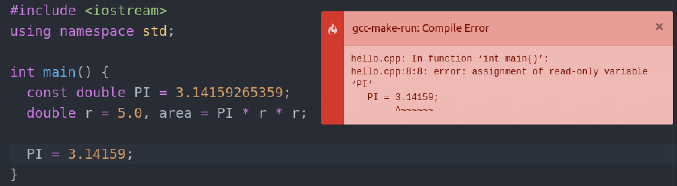
Constant Variables
Sometimes we want to assign a fixed value to a variable
Add a constant modifier in front of a variable declaration
The compiler will make sure that the variable remains a constant
double PI = 3.14159265359;
Line 8 “PI = 3.14159;” generates a compile error since PI is declared as a constant variable in line 5, but here we attempt to change its value
You can see that this helps to ensure the value of a variable will not be changed accidentally.
Notes:
What is this kind of error?

Slide 34
Expressions
Combine variables and constants to produce new values (i.e., to evaluate an expression)
Composed of operators (instructions) and operands (data)
Operators
Specify what is to be done on the operands
E.g., arithmetic operators, relational operators, logical operators
Operands
Data on which the computation is performed
May be variables and/or constants
operands
radius * 2 * 3.1416
operators

Slide 35
Operators
Arithmetic operators (+, –, *, /, %)
Relational operators (>, >=, <, <=, ==, !=)
Logical operators (&&, ||, !)
Increment and decrement operators (++, --)
Assignment operators (=, +=, -=, *=, /=)

Slide 36
Arithmetic Operators
Arithmetic Operators | Sign in the expression
Addition | +
Subtraction | -
Multiplication | *
Division | /
Modulus | %
The modulus operator % produces the remainder.
E.g., 13 % 3 results in 1
because 13 = (3 * 4) + 1

Slide 37
Arithmetic Operators
Note: when both operands of the / operator are of integer types, the / operator performs integer division which truncates any fractional part of the division result.
The operator % cannot be applied to double (i.e., floating point numbers).
int a = 3, b = 2;
int c = a / b, d = 8 / 3;
cout << "The value of c is " << c << endl ;
cout << "The value of d is " << d << endl ;
What is the screen output?
The value of c is 1
The value of d is 2

Slide 38
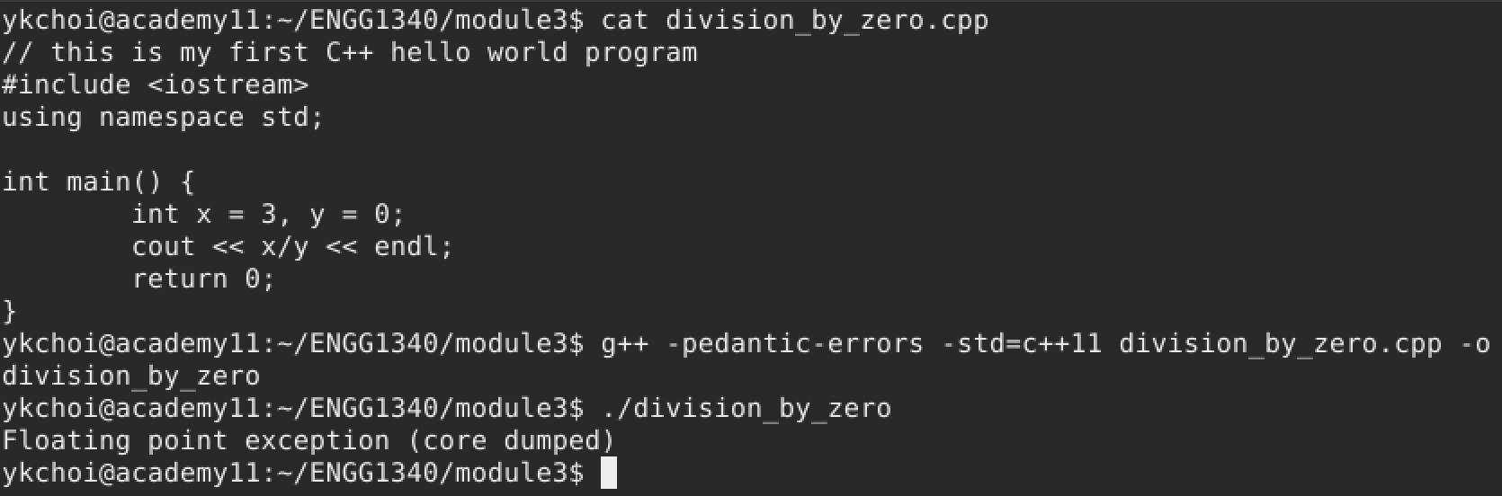
Division by Zero
If the divisor of the / operator is 0, a division by zero error will be generated during runtime.
Note that no compilation error will be generated.

Slide 39
Precedence
In evaluating an expression with mixed operators, those operators with a higher priority will be carried out before those with a lower priority.
The operator * has a higher precedence than the operator +.
The order of evaluation is equivalent to 1 + (2 * 3).
1 + 2 * 3
Result: 9 or 7?
✗
✓

Slide 40
Precedence
In evaluating an expression with mixed operators, those operators with a higher priority will be carried out before those with a lower priority.
The operator % has a higher precedence than the operator –.
The order of evaluation is equivalent to 12 – (11 % 3).
12 – 11 % 3
Result: 1 or 10?
✗
✓

Slide 41
Precedence & Associativity
Operator types | Operators | Associativity
unary | +, –, ++, --, ! | -
binary arithmetic | *, /, % | left to right
binary arithmetic | +, – | left to right
relational | <, <=, >, >= | left to right
relational | ==, != | left to right
logical | && | left to right
logical | || | left to right
assignment | =, +=, –=, *=, /=, %= | right to left
High precedence
Lower precedence
The order of evaluation may be overridden by inserting parentheses () into the expressions
e.g., (1 + 2) * 3 = 9

Slide 42
Arithmetic Operator for Characters
We may perform arithmetic operation with characters. In this case, the numerical representation as in the ASCII code for each character will be used in the calculation.
The following program also shows a common technqiues in converting a letter from upper case to lower case.
???
1: y
2: z
#include <iostream> using namespace std; int main()
{
char c = ‘Y’;
// convert a letter from upper case to lower case c = c – ‘A’ + ‘a’;
cout << "1: " << c << endl;
// advance to the next character c = c + 1;
cout << "2: " << c << endl;
return 0; }
Screen output
Can you convert a letter from lower case to upper case then?
The ASCII table:
www.asciitable.com

Slide 43
Relational Operators
Relational Operators | Sign in the expression
Greater than | >
Greater than or equal | >=
Smaller than | <
Smaller than or equal | <=
Equal | ==
Not equal | !=
same higher precedence
lower precedence
For comparing the operands.

Slide 44
Relational Operators
In C/C++, the numeric value of a relational or logical expression is 1 if the relation is true, and 0 if the relation is false.
???
cout << (a == b);
0
Suppose all 3 examples start with:
int a = 1, b = 2;
1
???
cout << (a > b);
0
2
???
cout << (a < b);
1
3

Slide 45
Relational Operators
int i = 1, lim = 2;
cout << (i < lim – 2) ;
???
0
4
The “–” operator is of higher precedence than the “<” operator, so “lim – 2” is executed first
int i = 1, lim = 2;
cout << ( (i < lim) – 2 );
???
-1
5
The bracket () overrides precedence and associativity, hence (i < lim) is first evaluated to yield the intermediate result 1

Slide 46
Logical Operators
Operands |  | AND (&&) | OR (||) | NOT (!)
A | B | A && B | A || B | ! A
0 | 0 | 0 | 0 | 1
0 | 1 | 0 | 1
1 | 0 | 0 | 1 | 0
1 | 1 | 1 | 1
0: False
1: True
Precedence: (High) ! > && > || (Low)
C++ treats any non-zero value as true, and zero as false
Hence (3 && 0) is false, and (-5 || 0) is true
The unary negation operator ! converts a non-zero operand into 0, and a zero operand into 1 (e.g., ! 3 is evaluated to 0)

Slide 47
Logical Operators
???
int x = 5;
bool in_range = ! (x < 0 || x > 50);
cout << in_range << endl;
1
1
Both expressions connected by || evaluate to a false value (0)
bool i_am_cool = (gals != 0) && ((gifts / gals) >= 2);
2
No! Because: C/C++ evaluates a logical expression from left to right, and stops evaluating once the truth or falsehood of the result is known.
(a.k.a. short-circuit evaluation)
What if gals is 0? Will gifts/gals generate a runtime error?
Hence, if gals is 0, the expression ((gals != 0) && ???) must be false anyway, so the expression (gifts / gals) >=2 will NOT be evaluated, and thus not generating a runtime error.
There is similar short-circuit evaluation for the || operator: bool omg = (gals == 0) || ((gifts / gals) < 2);

Slide 48
Increment & Decrement Operators
Assignment Operators | Sign in the expression
Increment | ++
Decrement | --
The increment operator ++ adds 1 to its operand.
The decrement operator -- subtracts 1 from its operand.
int i = 0;
++i ;
int i = 0;
i = i + 1;
is equivalent to
int i = 0;
--i ;
int i = 0;
i = i – 1;
is equivalent to

Slide 49
Increment & Decrement Operators
The operators ++ and -- may be used either as prefix (e.g., ++i) or postfix (e.g., i++) operators.
When used as prefix, increment/decrement is done before the value is used.
When used as postfix, increment/decrement is done after the value is used.
int c = 0, i = 0; c = ++i ;
int c = 0, i = 0; i = i + 1; c = i;
c = ??? i = ???
is equivalent to
int c = 0, i = 0; c = i++;
int c = 0, i = 0; c = i;
i = i + 1;
c = ??? i = ???
is equivalent to

Slide 50
Assignment Operators
Expression such as i=i+2 in which the variable on the left-hand side is repeated immediately on the right can be written in the compressed form i+=2
Most binary operators have a corresponding compound assignment operator, e.g., -=, *=, /=, and %=
Examples
x *= y + 1;
is equivalent to
x = x * (y + 1);
x %= y % 3;
is equivalent to
x = x % (y % 3);

Slide 51
Type Conversions
When an operator has operands of different types, they are converted to a common type according to a small number of rules.
1
“lower” type promoted to “higher” type
3.0 / 2;
2 (int) is promoted to 2.0 (double), and the result is 1.5
Important: Compare this with
3 / 2;
No type conversion because both 3 and 2 are integers, therefore integer division is carried out, and the result is 1

Slide 52
Type Conversions
2
In assignment statements, the value of the right side is converted to the type of the left
double x = 5;
x stores the value 5.0
int x = 2.8;
Converting a double value to an int value causes truncation of any fractional part
x stores the value 2
* The compiler may issue a warning as there is information loss.
int x = (int) 2.8;
Explicit type casting tells the compiler it is an intended type conversion and prevents the compiler from producing a warning. x stores the value 2
* The compiler generates no warning
This also shows that you, as the programmer, can control how values are stored.

Slide 53
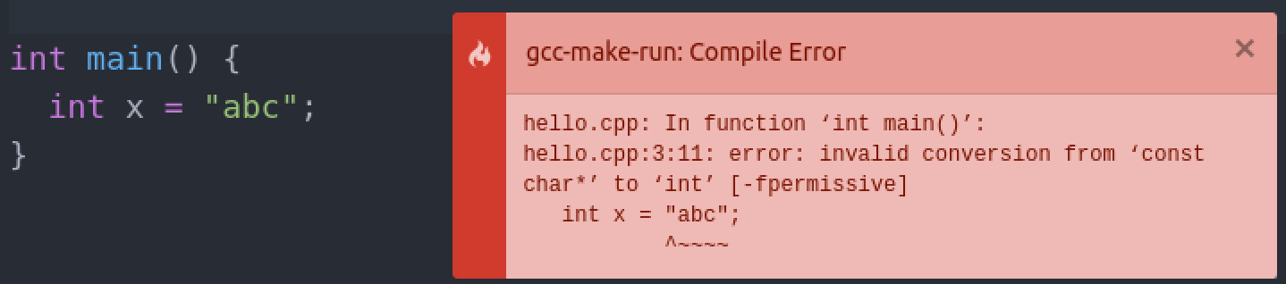
Type Conversions
3
Type conversions that don’t make sense are not allowed.
e.g., assigning a string literal to an int variable generates a compilation error:

Slide 54
Basic I/O (Input/Output)
A stream is an object where a program can either insert or extract characters to/from it.
We may use streams to perform input and output operations in sequential media such as the screen or the keyboard.
The standard C++ library includes the header file iostream where the standard input and output stream objects are declared.
We need to include the header file by the #include directives before using any objects and functions in the iostream library.
#include <iostream>
using namespace std;
int main () { … }
Include the iostream library to use cin and cout. The iostream library is some existing object codes developed by others. As this is so useful, it is regarded as standard C++ library.

Slide 55
Basic I/O
#include <iostream>
using namespace std;
int main () { cout << “Hello!” << endl; }
This statement is important!
Because cout and endl are provided under the namespace (i.e., a container of names) std. Their names are indeed std::cout and std::endl.
✗
✓
#include <iostream>
int main () { cout << “Hello!” << endl; }
#include <iostream>
int main () { std::cout << “Hello!” << std:: endl; }
a.cpp: In function int main():
a.cpp:4: error: 'cout' was not declared in this scope a.cpp:4: error: 'endl' was not declared in this scope
Compiler error

Slide 56
Standard Output
By default, the standard output of a program is the screen, and the C++ stream object defined to access it is cout.
The insertion operator << is used to insert data into the stream, which may be used more than once in a single statement.
Hello
World!
int a = 1 , b= 2, c = 3;
cout << “Hello ”; cout << “World!” << endl;
cout << 1 << a << endl;
cout << “b = ” << b << “ and c = ” << c << endl;
11
b = 2 and c = 3
Screen output
Note that there is no line break after “Hello ” and “World!”
Also there is no space between 1 and the value of a in the 2nd output line.

Slide 57
Standard Output
There are some escape sequences that have special usage in the output.
\a | alert (bell) character | \v | vertical tab
\b | backspace | \\ | backslash
\n | newline | \? | question mark
\r | carriage return | \’ | single quote
\t | horizontal tab | \” | double quote
cout << a << endl;
cout << “Hi!” << endl;
cout << a << ‘\n’;
cout << “Hi!\n”;
is equivalent to
Try out these escape sequences in a program and see the result!

Slide 58
Standard Input
From time to time, we need to obtain user input to our program.
The standard input device is usually the keyboard, and the C++ stream object defined to access it is cin.
The extraction operator >> is used to extract data from the stream
The type of the variable will determine the type of data that is extracted from the stream.
Note that cin can only process the input from the keyboard once the RETURN key has been pressed.
int x;
cin >> x;
char x;
cin >> x;
vs.
An integer is expected to be input
A character is expected to be input

Slide 59
A Sample Program on I/O
Be careful about the directions of the << and >> operators!
#include <iostream>
using namespace std;
int main(){
int age;
double height, weight;
cout << "Please input your age, height and weight: ";
cin >> age >> height >> weight;
cout << endl << "Your age is " << age << endl;
cout << "Your height is " << height << endl;
cout << "Your weight is " << weight << endl;
return 0;
}
Please input your age, height and weight:
Screen output

Slide 60
A Sample Program on I/O
#include <iostream>
using namespace std;
int main(){
int age;
double height, weight;
cout << "Please input your age, height and weight: ";
cin >> age >> height >> weight;
cout << endl << "Your age is " << age << endl;
cout << "Your height is " << height << endl;
cout << "Your weight is " << weight << endl;
return 0;
}
user input from keyboard
Please input your age, height and weight:
Please input your age, height and weight: 20 175.5 132
Screen output

Slide 61
A Sample Program on I/O
#include <iostream>
using namespace std;
int main(){
int age;
double height, weight;
cout << "Please input your age, height and weight: ";
cin >> age >> height >> weight;
cout << endl << "Your age is " << age << endl;
cout << "Your height is " << height << endl;
cout << "Your weight is " << weight << endl;
return 0;
}
Please input your age, height and weight: 20 175.5 132
Please input your age, height and weight: 20 175.5 132
Your age is 20
Your height is 175.5
Your weight is 132
Screen output

Slide 62
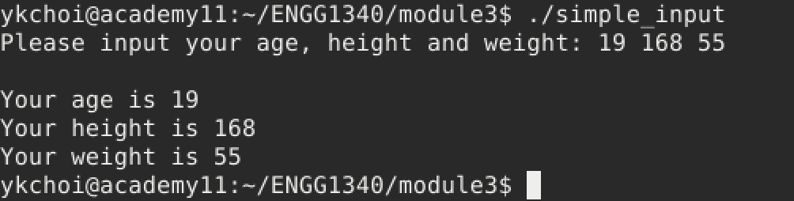
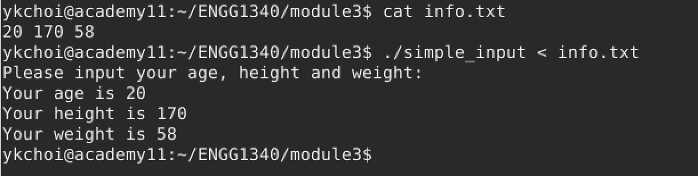
Using File Redirection as Standard Input to Your Program
Sometimes it is just too tiring to enter the input values to your program again and again, especially during the testing and debugging stages. In this case, you may execute your program using command line and file redirection so that the contents of a file will be fed into your program as if they are from the standard input (i.e., by default the keyboard)
User input from keyboard
User input stored in a file “info.txt” and use file redirection to fed file contents to the program as input.

